Slide 1
Introduction to Drilling Data Analytics with Python
Peter Kowalchuk
Online Course - October 2024

Slide 2
Thursday

Slide 3
Recap
More on Python classes
Lasio library
Operations with Dataframes
Importing different data file types: csv, las, witsml
Handling log data by columns
Splicing logs

Slide 4
Managing Operations
Using Data Analytics
Was this well executed as expected?
Determine if a new drilling tool should be utilized
In a new contract, what are the expected metrics?
Which drilling package needs to increase its performance?
What should be done to increase the performance of a drilling package?

Slide 5
Managing Operations
Management tools
Metrics
What can be measured
KPI - Key Performance Indicators
Metric with operational limits
OKR - Objectives and Key Results
Objective: what we want to accomplish
Key Result: progress towards the objective
Initiative: what we will do to meet the objective

Slide 6
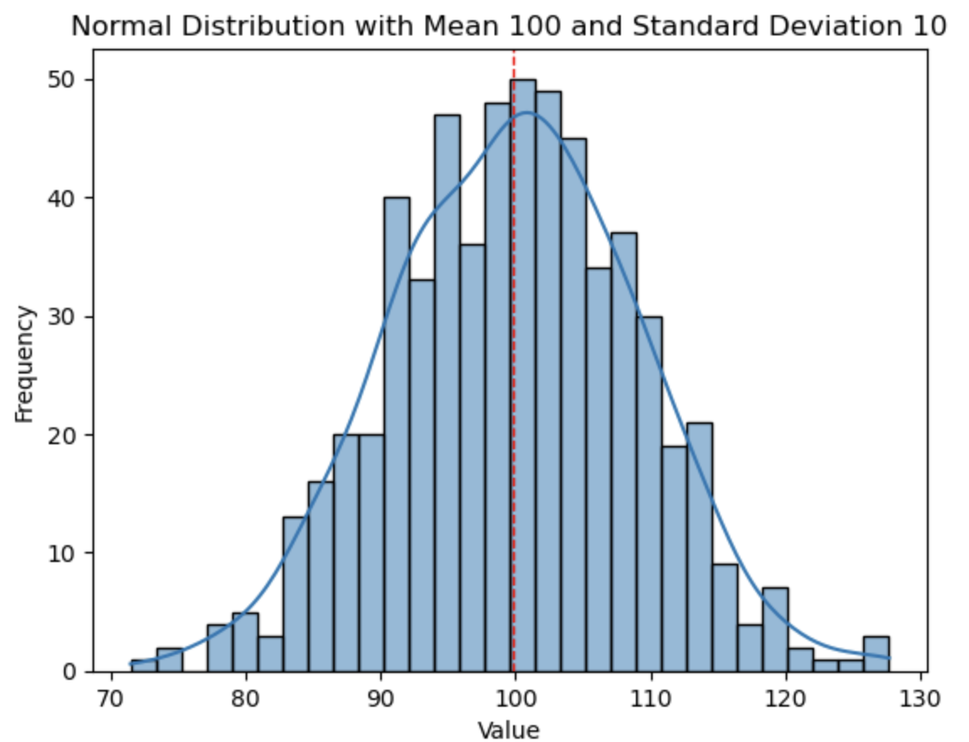
Metrics
Measuring operations
Defined by:
Mean
Standard Deviation
Examples:
Average ROP (m/hr)
Average NPT (%)
Days to Total Depth (m)
Total Footage per Well (m)
Well Tortuosity
Percent of Contact Footage (%)
Tripping Speed (m/hr)
Slip to Slip (min)
Slip to Bottom (min)
Bottom to Slip (min)

Slide 7
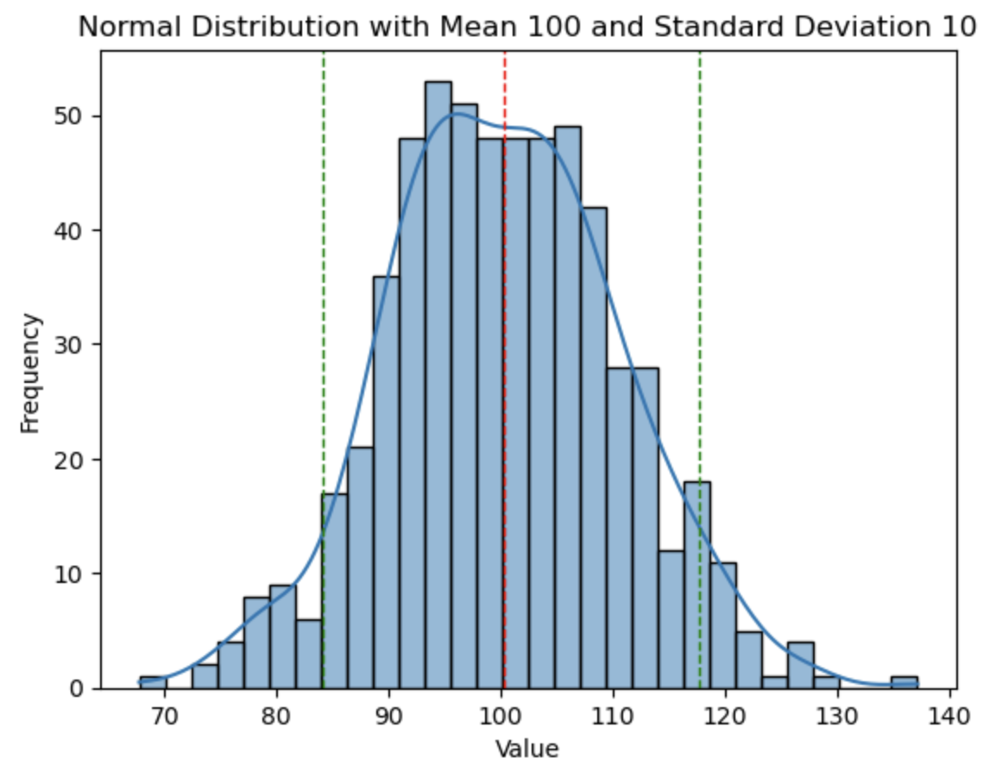
KPI - Key Performance Indicators
Defining operational results with limits
We add confidence intervals to the metrics
Confidence ranges tell us that the metric has a probability that its population is within that range with a probability X%
Typically X is 90%, 95% o 99% (in medicine)
This percentage represents the risk we are willing to take

Slide 8
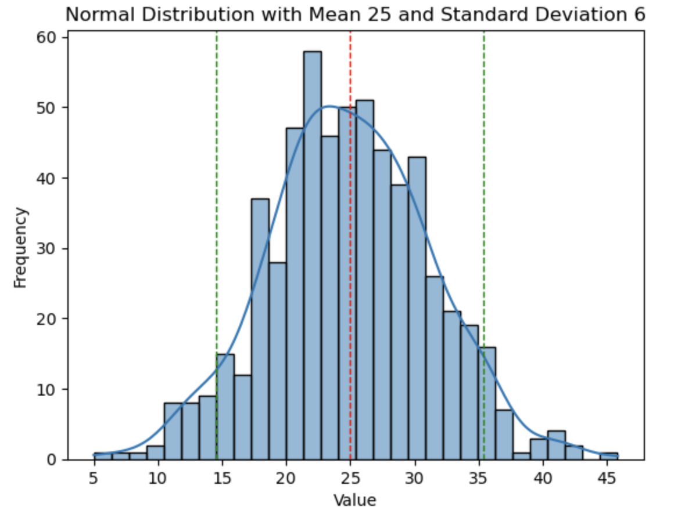
KPI - Key Performance Indicator
Example
After drilling 600 wells:
The average to complete a well is: 25 days
Standard deviation is: 6 days
With a confidence of 90%, how many days will it take to drill the next well?
It will take between 14.54 and 35.33 days

Slide 9
OKR - Objectives and Key Results
Actively managing using results
Objective
What we want to accomplish
Key Result
Metric towards the objective
Initiatives
Actions we need to take to achieve the key results

Slide 10
OKR - Objectives and Key Results
Actively managing using results
Initiatives
Add a new drilling package
Is there enough evidence to not contract that package?
Is the average of days required to complete a well is smaller that the general average?
Implement connections training?
Is there enough evidence to implement the training?
Is the connection time statistically better?

Slide 11
OKR - Objectives and Key Results
Example
Objective
To be the best operator in the Melones field
Key Result
Reduce the connection time from 9 to 6 minutes
Initiatives
Send crew to “Efficient Connection Practices”

Slide 12
Art of the possible
Analysis examples and new technologies
How are we using Data Analytics
New technologies
Unstructured data and NLP
Sentiment Analysis
Artificial Intelligence
AI Libraries
ChatGPT y LLM

